Slide 1
Module 10
Describing Manifestations (and some attributes of Works and Expressions)
RDA Training
University of Nevada, Reno
February 2013
Notes:
We’re going to move on to bibliographic records now from authority records and the title of this module has to equivocate a bit because some bits of the work and expression description takes place in the bibliographic record, not the authority record. What we will not be covering in this module is relationships, that is, access points. This module will concentrate on books; other formats later.

Slide 2
Please log in to RDA
http://access.rdatoolkit.org/?username=RDATraining&password=Wolfie13
Reno Workshop: Please feel free to sign up later for a month’s free access so you can practice (see handout)
Notes:
From now on, as I show slides of RDA, please feel free to go ahead and look yourself in the Toolkit.

Slide 3
ISBD Punctuation
AACR2 prescribes the use of ISBD punctuation.
RDA does not prescribe any display standard
  Since it is understood that most libraries will continue to use ISBD, RDA Appendix D lays out ISBD guidelines, including two new ISBD practices that were not followed in AACR2
  This workshop assumes ISBD punctuation in MARC format

Slide 4
ISBD Change: Bracketing
Each adjacent data element that requires square brackets is enclosed in its own set of square brackets.
Previous practice
260 $a [Washington, D.C. : $b G.P.O? : $c 2009?]
New practice
260 $a [Washington, D.C.] : $b [G.P.O?] : $c [2009?]
Notes:
Note this is not an RDA change

Slide 5
ISBD Change: Ending punctuation
When an element or area ends with a full stop, the full stop for prescribed punctuation is also added.
Current practice
250 1st ed.
Future practice
250 1st ed..
Note: this example assumes that the abbreviation “ed.” is being transcribed. The word “edition” would not be abbreviated in RDA.

Slide 6
Coding Records for RDA
Bibliographic records
  Leader/18 (Desc) = “i”.
  040 contains $b eng and $e rda.
Notes:
We’ll be working on RDA bibliographic records during this workshop. Code your worksheet for RDA.

Slide 7
FRBR Primary Entities
Work
  Expression
    Manifestation
      Item
Notes:
This module will speak about creating records and access points for Manifestations, but also some aspects of work and expression. RDA has not yet formulated a way to create access points for manifestations and items.

Slide 8
Identifying Manifestations and Items: Important Definitions
1.1.5. The term manifestation refers to the physical embodiment of an expression of a work.
1.1.5. The term item refers to a single exemplar or instance of a manifestation
1.1.2. The term resource is used in Chapers 2-4 to refer to a manifestation or item.
1.1.3. Mode of issuance
  resource issued as a single unit refers to a resource that is issued either as a single physical or a single logical unit
  multipart monograph refers to a resource issued in two or more parts that is complete or intended to be complete in a finite number of parts
  serial refers to a resource issued in successive parts, usually bearing numbering, that has no predetermined conclusion
  integrating resource refers to a resource that is added to or changed by means of updates that do not remain discrete
Notes:
Think of some examples of manifestations.
NOTE: all the modes of issuance apply to resources, that is, manifestations.
Think of some examples of single unit resources, multipart monograph, serial, integrating resource
We’ll be learning about serials and integrating resources in a later module. This module will only cover monographs.

Slide 9
Identifying Manifestations:
Core Elements (1.3)
“Core”
title proper
first statement of responsibility
designation of edition
designation of named revision of an edition
serial numbering
date of production (for resource in unpublished form)
Notes:
The core elements have been somewhat simplified for this presentation

Slide 10
Identifying Manifestations:
Core Elements (1.3)
“Core”
publication statement (first place, first publisher, date of publication)
series statement (title proper, numbering, subseries)
identifier
carrier type
extent (if the resource is complete)

Slide 11
Identifying Manifestations:
Core Elements (1.3)
“Core if”
distribution statement elements (if corresponding publication information elements were not recorded)
copyright date (if neither date of publication nor date of distribution identified)
manufacture statement elements (if corresponding publication, distribution, nor copyright information elements were not recorded)

Slide 12
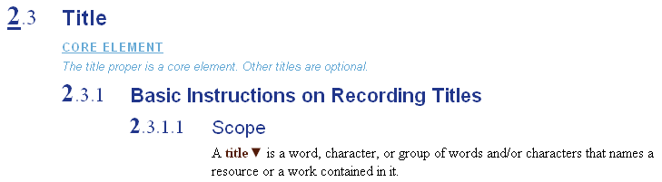
Core Elements in RDA
In addition to the list in 0.6 and 1.3, Core elements are identified throughout RDA, as in this example.
Notes:
Everyone please now open RDA to 2.3. You do not need to memorize the list in 1.3. The core requirements are repeated within the text.

Slide 13
Language and script (1.4)
Some elements are recorded in the language and script in which they appear, usually transcribed:
  Title
  Statement of responsibility
  Edition statement
  Numbering of serials
  Production, publication, distribution, manufacture statement
  Series statement

Slide 14
Language and script (1.4)
All other elements are recorded in the language and script preferred by the cataloging agency
This is English for most agencies in the United States
Notes:
What elements might these other elements be? (Notes, the “types”, etc.)

Slide 15
Changes Requiring a New Description (1.6)
Multipart monograph:
  Change in mode of issuance or media type
Serial:
  Change in mode of issuance or media type
  Major change in title proper
  Change in responsibility if the name of the responsible entity is part of the serial’s authorized access point
  Change in edition statement
Notes:
Monograph: e.g. the monograph becomes a serial or an integrating resource; media type: multipart monograph starts out ink on paper, later volumes published on CD
Note: change in title of a multipart monograph somewhere along the way does NOT require a new description, just a note in the existing description.

Slide 16
Capitalization of transcribed elements (1.7)
Follow Appendix A or
Follow an in-house guide or policy or
When ingesting digital data (e.g. copy and paste) accept the data without modification.
Most catalogers are continuing to follow Appendix A, which is similar to AACR2’s capitalization rules
Notes:
Have a look at Appendix A

Slide 17
Capitalization of transcribed elements (1.7)
Appendix A.4 (Manifestations)
  Capitalize the first word in a title; capitalize other words according to the language (A.10-A.55)
Notes:
Have a look at Appendix A

Slide 18
Punctuation of transcribed elements (1.7.3)
Transcribe punctuation as it appears. Add missing punctuation if necessary for clarity.
Notes:
Look at 1.7.3.

Slide 19
Diacritical marks and symbols: transcribed elements (1.7.4-5)
Transcribe diacritical marks as they appear. Optionally, add missing diacritical marks in accordance with the standard usage of the language.
Reproduce symbols if possible. If not possible, replace them with a description in square brackets.
Notes:
Look at 1.7.3.

Slide 20
Abbreviations: transcribed elements (1.7.4-5)
Transcribe only abbreviations present in the source. Do not abbreviate words not abbreviated in the source. (See also Appendix B.4)
Notes:
Look at 1.7.3.

Slide 21
Inaccuracies: transcribed elements (1.7.4-5)
Do not correct or draw attention to inaccuracies when transcribing. No “sic” or “i.e.”
Notes:
Look at 1.7.3.

Slide 22
Identifying Manifestations
Title Proper
Title proper is defined as “the chief name of a resource,” and includes alternative title (2.3.2.1)
Title proper is a core element, i.e., required.
Title proper should be taken from the “preferred source of information” (see 2.2.2-2.2.3). For a book, this is the title page, just as in AACR2

Slide 23
Identifying Manifestations
Title Proper
Recording titles
2.3.1.4. Transcribe a title as it appears on the source of information. Apply the general guidelines on transcription given under 1.7.
1.7. Capitalization: apply Appendix A (option to capitalize as found on source)
Punctuation: transcribe as it appears; add punctuation if necessary for clarity
Diacritical marks: transcribe as they appear; optionally add missing diacritical marks
Inaccuracies: transcribe an inaccuracy or misspelled word as it appears in the source.
Notes:
We already looked closely at 1.7. This is a reminder, everything there applies to transcription of the title proper.

Slide 24
Identifying Manifestations
Title Proper (MARC)
Title proper is recorded in MARC bibliographic 245 field, subfield $a.
The second indicator is coded for non-filing characters, i.e. the number of spaces to skip before indexing.

Slide 25

Bibliographic Record
Title page
Title proper is recorded in 245 $a
Transcribe the title proper into an RDA worksheet
Notes:
Note capitalization change.

Slide 26
Bibliographic Record
245 14 $a The Cunningham family cookbook

Slide 27
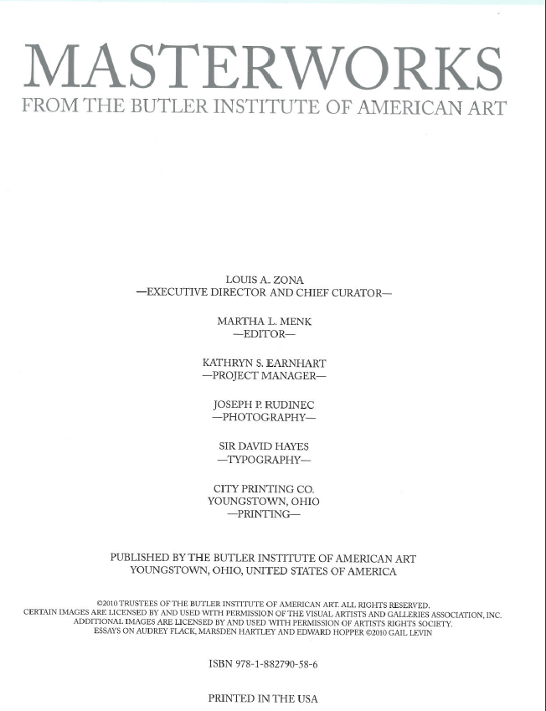
Bibliographic Record
Title page
Transcribe the title proper into the RDA worksheet

Slide 28
Bibliographic Record
245 10 $a Masterworks from the Butler Institute of American Art

Slide 29
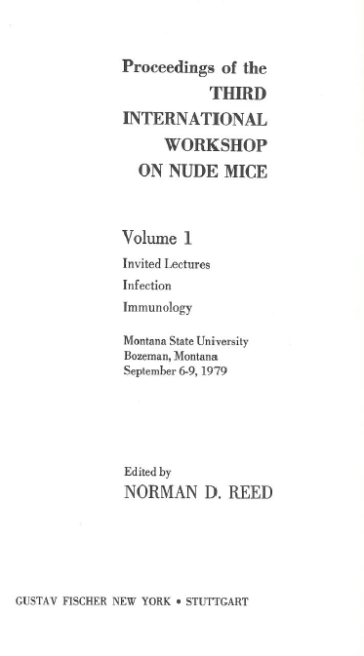
Bibliographic Record
Title page
Transcribe the title proper into the RDA worksheet
Notes:
Note that we’ve chosen the first volume to transcribe. This is the “basis for identification” Pause and have a look at 2.1.2.

Slide 30
Bibliographic Record
245 10 $a Proceedings of the Third International Workshop on Nude Mice

Slide 31
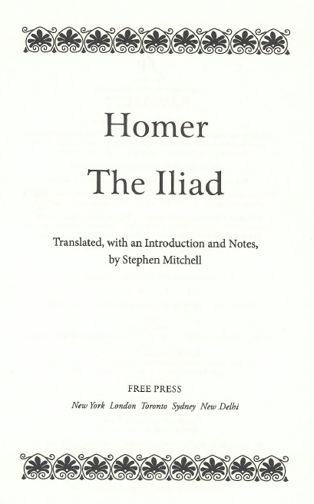
Bibliographic Record
Title page
Transcribe the title proper into the RDA worksheet

Slide 32
Bibliographic Record
245 14 $a The Iliad

Slide 33
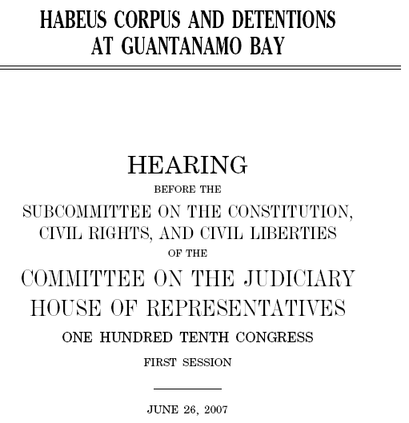
Inaccuracies
AACR2
245 10 Habeus [sic] corpus and detentions at Guantanamo Bay …
246 3 Habeas corpus and detentions at Guantanamo Bay
RDA
245 10 Habeus corpus and detentions at Guantanamo Bay …
246 3 Habeas corpus and detentions at Guantanamo Bay
Notes:
RDA does not correct, but recommends an added access point for the corrected title if in the cataloger’s judgment it would be helpful to the users of the catalog.

Slide 34
Parallel Title Proper
2.3.3. Parallel title proper is the title proper in another language and/or script.
Parallel titles can be taken from any source within the resource, does not need to appear with the title proper (change from AACR2)
Parallel title proper is not core, i.e., recording it is optional.
If it is recorded, it is transcribed in the same way as title proper.

Slide 35
Parallel Title Proper (MARC)
Parallel title proper is transcribed in subfield $b after the title proper.
Separate the title proper from the parallel title with an equals sign:
  245 10 $a Title proper = $b Parallel title proper

Slide 36

Bibliographic Record
Which is the title proper? (cf. 2.3.2.4)
Transcribe the title proper and the parallel title into a worksheet
Title page
Notes:
Read together 2.3.2.4

Slide 37
Bibliographic Record
245 10 $a Sun stone = $b Piedra de sol

Slide 38
Other Title Information
2.3.4. Other title information is information that appears in conjunction with, and is subordinate to, the title proper.
Other title information is taken from the same source as the title proper.
Other title information is not core, i.e., recording it is optional.
If it is recorded, it is transcribed in the same way as title proper.

Slide 39
Other Title Information (MARC)
Other title information is recorded in MARC bibliographic 245 subfield $b (if $b has not already appeared)
Separate other title information from previous elements by a colon
    245 10 $a Title proper : $b other title information
    245 10 $a Title proper = $b Parallel title proper : other title information

Slide 40
Bibliographic Record
Title page
Other title information is recorded following colon in 245 $b
Transcribe the other title information into the RDA worksheet
Notes:
Note capitalization change.

Slide 41
Bibliographic Record
245 14 $a The Cunningham family cookbook : $b recipes from our cousins

Slide 42
Statement of Responsibility
2.4.1. A statement of responsibility is a statement relating to the identification and/or function of any persons, families, or corporate bodies responsible for the creation of, or contributing to the realization of, the intellectual or artistic content of a resource.
The first statement of responsibility relating to the title proper is core, i.e., required. Others are optional.
Statements of responsibility relating to the title proper may be taken from any source in the resource, i.e., they do not have to appear with the title proper (change from AACR2)

Slide 43
Bibliographic Record
Title page
Statement of responsibility is recorded following slash in 245 $c
Transcribe statement of responsibility into the RDA worksheet
Notes:
What is the statement of responsibility relating to the title proper on this title page?

Slide 44
Bibliographic Record
245 10 $a Proceedings of the Third International Workshop on Nude Mice / $c edited by Norman D. Reed.

Slide 45
Bibliographic Record
Transcribe the first statement of responsibility into the RDA worksheet
Title page
Subsequent statements of responsibility are not core. If recorded they are separated from each other by a semicolon. Transcribe the second statement of responsibility
Notes:
Note capitalization change.

Slide 46
Bibliographic Record
RDA core
245 10 $a Sun stone / $c Octavio Paz.
RDA with elements beyond core
245 10 $a Sun stone = $b Piedra de sol / $c Octavio Paz ; translation by Muriel Rukeyser.

Slide 47
Bibliographic Record
Transcribe statements of responsibility into the RDA worksheet
Notes:
Note capitalization change.

Slide 48
Bibliographic Record
RDA core
245 14 $a The Iliad / $c Homer.
RDA with elements beyond core
245 14 $a The Iliad / $c Homer ; translated, with an introduction and notes, by Stephen Mitchell.

Slide 49
Statement of Responsibility
NO RULE OF THREE!
In AACR2 if more than three names appeared in a statement of responsibility, the statement was abridged to name only one
There is no such rule in RDA.
2.4.1.5. Record a statement of responsibility naming more than one person, etc., as a single statement ...

Slide 50
Statement of Responsibility
Optional omission
Optionally, statement of responsibility naming more than three persons may be abridged:
2.4.1.5. Optional omission. ... omit all but the first of each group ... indicate the omission by summarizing what has been omitted ...
Roger Colbourne [and six others]

Slide 51


Bibliographic Record
Double title page
Transcribe the title proper, other title information, and statement of responsibility into an RDA worksheet
Notes:
Note: that really is how the t.p. appears, it’s not badly cropped.

Slide 52
Bibliographic Record
RDA
245 00 $a Regarding Warhol : $b sixty artists, fifty years / $c Mark Rosenthal, Marla Prather, Ian Alteveer, Rebecca Lowery.
RDA with optional omission
245 00 $a Regarding Warhol : $b sixty artists, fifty years / $c Mark Rosenthal [and three others].
Notes:
I hope no one will take the option with only four names.

Slide 53
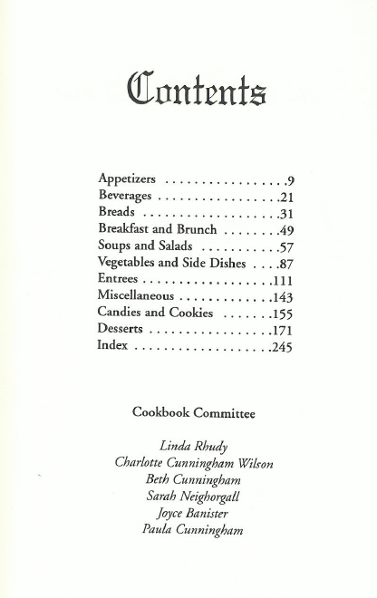
Statement of Responsibility
Sources
Statement of responsibility can come from anywhere in the resource without bracketing
Transcribe statement of responsibility into the RDA worksheet

Slide 54
245 14 $a The Cunningham family cookbook : $b recipes from our cousins / $c cookbook committee, Linda Rhudy, Charlotte Cunningham Wilson, Beth Cunningham, Sarah Neighorgall, Joyce Banister, Paula Cunningham.

Slide 55
Statement of Responsibility:
What to record?
Reread scope, 2.4.1.1
Record the statement of responsibility in your worksheet
Notes:
What would you record ??? Who contributed to the intellectual or artistic content of the resource?

Slide 56
Bibliographic Record
245 10 $a Masterworks from the Butler Institute of American Art / $c Martha L. Menk, editor ; Joseph P. Rudinec, photography.

Slide 57
Edition statement
2.5. An edition statement is a statement identifying the edition to which a resource belongs.
Edition statement can be taken from any source within the resource.
Edition statement is core, i.e., required.
Unlike AACR2, RDA edition statements are transcribed exactly as found, not abbreviated (unless abbreviations are found on source)

Slide 58
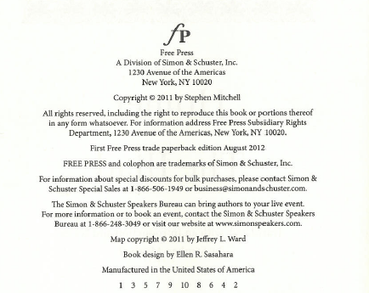
Bibliographic Record
Title page verso
Transcribe the edition statement into the RDA worksheet. Use 250 $a.
Notes:
Note capitalization change.

Slide 59
Bibliographic Record
250 $a First Free Press trade paperback edition.
or
250 $a First Free Press trade paperback edition August 2012.

Slide 60
Publication Statement
2.8. A publication statement is a statement identifying the place or places of publication, publisher or publishers, and date or dates of publication of a resource.
The first place of publication, the first publisher, and date of publication are core, i.e. required. Optionally, the entire publication statement may be recorded.
Publication statement may be taken from any source within the resource.

Slide 61
Publication Statement
AACR2 abbreviates and shortens
AACR2 has complex rules for multiple places and publishers
AACR2 uses abbreviations “s.l.” and “s.n.” when place or publisher unknown
RDA does not abbreviate or shorten
RDA records names in the order found in the source
RDA uses phrases to indicate unknown information

Slide 62
Publication Information
“Core if” elements
  If place of publication is not identified, place of distribution is core; if place of distribution also not identified, place of manufacture is core.
  If publisher’s name is not identified, distributor’s name is core; if distributor’s name also not identified, manufacturer’s name is core.
  If date of publication is not identified, date of distribution is core; if date of distribution also not identified, copyright date is core; if copyright date also not identified, date of manufacture is core.

Slide 63
Publication Information
(MARC 264 - NEW!)
  First indicator
    blank = earliest statement
    2 = intervening statement
    3 = latest statement
  Second indicator
    0 = production statement
    1 = publication statement
    2 = distribution statement
    3 = manufacture statement
    4 = copyright statement
  Subfield codes
    a = place
    b = name
    c = date
Notes:
Look at 264 in MARC format
If you want to record more than one type of statement, e.g. a publication statement and a copyright statement, use two fields.

Slide 64
Publication Information
Place
RDA 2.8.1.4. Transcribe places of publication and publishers' names in the form in which they appear on the source of information.
RDA 2.8.2.3. Record the place of publication applying the basic instructions on recording publication statements given under 2.8.1 . Include both the local place name (city, town, etc.) and the name of the larger jurisdiction or jurisdictions (state, province, etc., and/or country) if present on the source of information

Slide 65

Publication Information
Place
AACR2
260 $a Princeton, N.J. : $b Princeton University Press, $c c1999.
RDA core
264 1 $a Princeton, New Jersey : $b Princeton University Press, $c [1999].

Slide 66
Publication Information
More than one place
RDA 2.8.2.4. If more than one place of publication is named on the source of information, record the place names in the order indicated by the sequence, layout, or typography of the names on the source of information.

Slide 67


Publication Information
More than one place
AACR2 (U.S. agency)
260 $a London ; $a New York : $b Oxford University Press, $c c1941.
RDA core
264 1$a London : $b Oxford University Press, $c [1941]
RDA with optional elements
264 1 $a London ; $a Toronto ; $a New York : $b Oxford University Press, $c [1941]
264 4 $c ©1941

Slide 68
Publication Information
Place of publication not identified
RDA 2.8.2.6. If the place of publication is not identified in the resource, supply the place of publication or probable place of publication ... If neither a known nor a probable local place or country, state, province, etc., of publication can be determined, record Place of publication not identified.
Note: According to the core element set, if a place of publication is not identified the cataloger must attempt to record a place of distribution; if no place of distribution is identified, the cataloger must attempt to record a place of manufacture.
Notes:
Note: according to the core element set, if place of publication is not identified, cataloger must try to identify place of distribution, then place of manufacture.

Slide 69
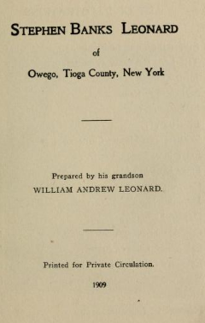
Publication Information
Place of publication not identified
AACR2
260 $a [S.l. : $b s.n.], $c 1909.
RDA
264 1 $a [Place of publication not identified] : $b [publisher not identified], $c 1909.

Slide 70
Publication Information
Publisher’s name
RDA 2.8.1.4. Transcribe places of publication and publishers' names in the form in which they appear on the source of information.
Optional Omission. Omit levels in a corporate hierarchy that are not required to identify the publisher.

Slide 71


Publication Information
Publisher’s name
AACR2
260 $a Columbus : $b C.E. Merrill Pub. Co., $c c1966.
RDA
264 1 $a Columbus, Ohio : $b Charles E. Merrill Publishing Co., A Bell and Howell Company, $c [date of publication not identified]
264 4 $c ©1966
Notes:
Note, corporate hierarchy (Bell and Howell) could have been omitted. The date in the RDA publication statement could also have been supplied, [1966]

Slide 72
Publication Information
More than one publisher
RDA 2.8.4.5. If more than one person, family, or corporate body is named as a publisher of the resource, record the publishers' names in the order indicated by the sequence, layout, or typography of the names on the source of information.

Slide 73

Publication Information
More than one publisher
AACR2
260 $a Berkeley : $bUniversity of California Press, $c c2006.
RDA
264 1 $a Berkeley : $b University of California Press ; $a Chicago : $b Center for Black Music Research, Columbia College, $c [2006]
Notes:
Note: only first publisher is core element.

Slide 74
Publication Information
Publisher not identified
RDA 2.8.4.7. For a resource in a published form, if no publisher is named within the resource itself, and the publisher cannot be identified from other sources as specified under 2.2.4, record publisher not identified.
Note: According to the core element set, if publisher is not identified the cataloger must attempt to record a distributor; if no distributor is identified, the cataloger must attempt to record a manufacturer.

Slide 75
Publication Information
Publisher not identified
AACR2
260 $a [S.l. : $b s.n.], $c 1909.
RDA
264 1 $a [Place of publication not identified] : $b [publisher not identified], $c 1909.

Slide 76
Publication Information
Date
RDA 2.8.1.4. Record dates of publication applying the general guidelines on numbers expressed as numerals or as words given under 1.8.
RDA 1.8.2. Record numerals in the form preferred by the agency creating the data, unless the substitution would make the numbering less clear.
Alternative rule. Record numerals in the form in which they appear on the source of information. (LC follows the alternative.)
Note: there is no stipulation in RDA to substitute arabic numerals for roman numerals.

Slide 77
Publication Information
Supplied Dates (RDA 1.9.2)
Actual year known [2003]
Either one of two consecutive years [1971 or 1972]
Probable year [1969?]
Probable range of years [between 1970 and 1979?]
Earliest and/or latest possible date known
[not after August 21, 1492]
[not before 1850]
[between August 12, 1899 and March 2, 1900]
Note: “ca.” (or “approximately”) is not permitted in RDA

Slide 78
Publication Information
Supplied Dates (RDA 1.9.2)
AACR2 RDA
[ca. 1960] [1960?], or something like
[between 1958 and 1962]
[188-] [between 1880 and 1889]
[17--] [between 1700 and 1799]
[not after Sept. 10, 1495] [not after September 10, 1495]

Slide 79
Publication Information
Copyright and Date of Manufacture
AACR2
c2010
p2006
1998 printing
RDA
264 4 $c ©2010 or copyright 2010
[if the symbol cannot be reproduced]
264 4 $c ℗2006 or phonogram 2006
[if the symbol cannot be reproduced]
264 3 $c 1998.

Slide 80
Publication Information
Date
For published materials, the date of publication is a core element in RDA. In other words, something must be recorded in this element.
  Record the date of publication found in the manifestation or
  Supply a date of publication (in square brackets) or
  Record “[date of publication not identified]”
If the date of publication is not identified, the date of distribution becomes core.
If the date of distribution is not identified, copyright date becomes core.
If the copyright date is not identified, date of manufacture becomes core.
Notes:
For unpublished materials, the production statement, including date of production, is core.

Slide 81

Publication Information
Publication Date Known
AACR2
260 $a New York : $b Columbia University Press, $c 1959.
RDA
264 _1 $a New York : $b Columbia University Press, $c 1959.

Slide 82
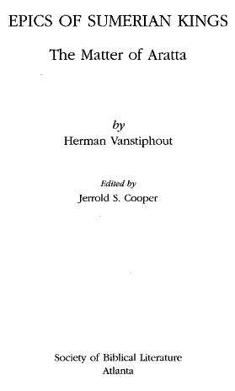

Publication Information
Copyright Date
AACR2
260 $a Atlanta : $b Society of Biblical Literature, $c c2003.
RDA
264 1 $a Atlanta : $b Society of Biblical Literature, $c [2003]
or
264 1 $a Atlanta : $b Society of Biblical Literature, $c [2003]
264 4 $c ©2003
or
264 1 $a Atlanta : $b Society of Biblical Literature, $c [date of publication not identified]
264 4 $c ©2003
Notes:
Note second RDA example goes beyond core.

Slide 83

Publication Information
Phonogram Date
AACR2
260 $a [Germany] : $b Naxos, $c [2002].
500 $a Phonogram date on label and container: p1987 [sic].
RDA
264 1 $a [Germany] : $b Naxos, $c [2002]
264 4 $c ℗1987

Slide 84


Publication Information
Date of Manufacture
AACR2
260 $a [Bethesda, Md.] : $b U.S. Dept. of Health and Human Services, National Institutes of Health, National Cancer Institute, Division of Cancer Control and Population Sciences, $c 2008 printing.

Slide 85
Publication Information
Date of Manufacture
RDA
264 1 $a [Bethesda, Maryland] : $b U.S. Department of Health and Human Services, National Institutes of Health, National Cancer Institute, Division of Cancer Control and Population Sciences, $c [2008?]
or
264 1 $a [Bethesda, Maryland] : $b U.S. Department of Health and Human Services, National Institutes of Health, National Cancer Institute, Division of Cancer Control and Population Sciences, $c [date of publication not identified]
264 3 $c 2008.

Slide 86
Publication Information
Publication Date Not Identified
If the publication contains no publication date and it cannot be supplied, use “date of publication not identified” (RDA 2.8.6.6)
264 1 $a New York : $b Sear Publishing Company, $c [date of publication not identified]
However, it seems unlikely that this formulation would ever need to be used in the absence of distribution, copyright or manufacture date. At the very least the cataloger knows the manifestation was published before the date of cataloging.
264 1 $a New York : $b Sear Publishing Company, $c [not after November 1, 2012]

Slide 87
Title page and verso
Record the publication statement in the RDA worksheet
Notes:
Note capitalization change.

Slide 88
Bibliographic Record
Publication Statement
RDA core
264 -1 $a New York : $b Free Press, $c 2012.
RDA with elements beyond core
264 -1 $a New York ; $a London ; $a Toronto ; $a Sydney ; $a New Delhi : $b Free Press, $c 2012.
264 -4 $c ©2011

Slide 89
Title page
Record the publication statement in the RDA worksheet
Notes:
Note capitalization change.

Slide 90
Bibliographic Record
Publication Statement
RDA core
264 -1 $a Youngstown, Ohio, United States of America : $b The Butler Institute of American Art, $c [2010]
NOTE: Do not shorten elements.
RDA with elements beyond core
264 -1 $a Youngstown, Ohio, United States of America : $b The Butler Institute of American Art, $c [2010]
264 -4 $c ©2010

Slide 91
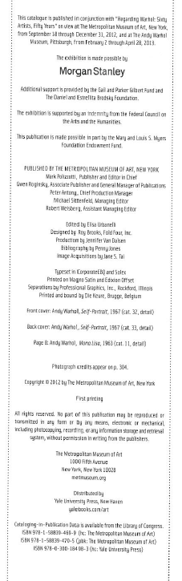
Record the publication statement in the RDA worksheet
Notes:
Verso says ©2012

Slide 92
Bibliographic Record
Publication Statement
RDA core
264 -1 $a New York : $b The Metropolitan Museum of Art, $c [2012]
RDA with elements beyond core
264 -1 $a New York : $b The Metropolitan Museum of Art, $c [2012]
264 -2 $a New Haven : $b Yale University Press
264 -4 $c ©2012

Slide 93
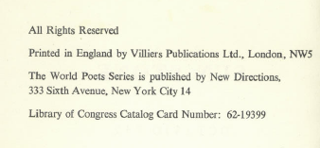
Title page and verso
Record the publication statement in the RDA worksheet
Notes:
No date of any kind is found on this book. What are you going to do?

Slide 94
Bibliographic Record
Publication Statement
RDA core
264 -1 $a New York City : $b New Directions, $c [1957?]
[or another date before 1962 (lccn) and after 1957, the date of publication of the first expression of the work]
or
264 -1 $a New York City : $b New Directions, $c [date of publication unidentified]
Optionally,
264 -3 $a London : $b Villiers Publications Ltd.

Slide 95
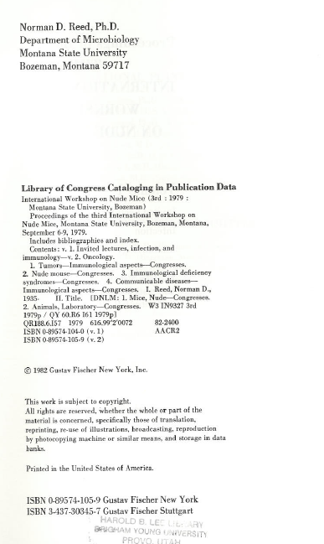
Title page and verso
Record the publication statement in the RDA worksheet
Notes:
Note capitalization change.

Slide 96
Bibliographic Record
Publication Statement
RDA core
264 -1 $a New York : $b Gustav Fischer, $c [1982]
RDA with elements beyond core
264 -1 $a New York ; $a Stuttgart : $b Gustav Fischer, $c [1982]
264 -4 $c ©1982

Slide 97
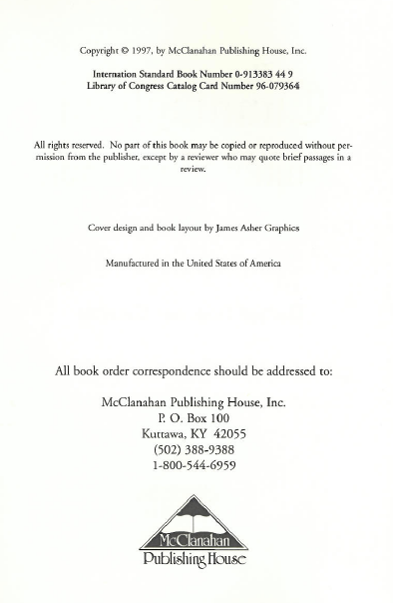
Title page and verso
Record the publication statement in the RDA worksheet
Notes:
Note capitalization change.

Slide 98
Bibliographic Record
Publication Statement
RDA core
264 -1 $a Kuttawa, KY : $b McClanahan Publishing House, $c [1997]
RDA with elements beyond core
264 -1 $a Kuttawa, KY : $b McClanahan Publishing House, $c [1997]
264 -4 $c © 1997

Slide 99
Describing Carriers
Instructions for recording the physical makeup of a manifestation are found in chapter 3, Describing Carriers
Definition of carrier: A physical medium in which data, sound, images, etc., are stored. For certain types of resources, the carrier may consist of a storage medium (e.g., tape, film) sometimes encased in a plastic, metal, etc., housing (e.g., cassette, cartridge) that is an integral part of the resource. (RDA Glossary)

Slide 100
Replacement of GMD
RDA has no provisions for AACR2’s General Material Designation (GMD)
RDA introduces instead
  Media type (3.2)
  Carrier type (3.3) (core element, i.e. not optional)
  Content type (6.9) (core element, i.e. not optional)

Slide 101
Media type
Categorization reflecting the general type of intermediation device required to view, play, run, etc., the content of a resource (RDA 3.2.1). Media type is not a core element.
Notes:
EVERYONE TURN TO 3.2. This is a complete list of the media types in RDA

Slide 102
Media type
MARC field 337
$a audio $2 rdamedia
337 $a unmediated $2 rdamedia
This element may be repeated if there is more than one media type. This can be done either with separate 337 fields, or by repeating subfield $a in a single 337 field.

Slide 103
Carrier type
Categorization reflecting the format of the storage medium and housing of a carrier in combination with the type of intermediation device required to view, play, run, etc., the content of a resource (RDA 3.3.1). Carrier type is a core element.
Notes:
everyone turn to 3.3

Slide 104
Carrier type
MARC field 338
$a videodisc $2 rdacarrier
338 $a volume $2 rdacarrier
This element may be repeated if there is more than one media type. This can be done either with separate 338 fields, or by repeating subfield $a in a single 338 field.

Slide 105
Content type
Categorization reflecting the fundamental form of communication in which the content is expressed and the human sense through which it is intended to be perceived. (RDA 6.9.1). Content type is a core element.
A few examples (not a complete list)
cartographic image
notated music
performed music
spoken word
still image
text
two-dimensional moving image
computer program
three-dimensional form
other
unspecified
Notes:
Everyone turn to 6.9. Note this is in Chapter 6 because it’s an attribute of expression.

Slide 106
Content type
MARC field 336
336 $a notated music $2 rdacontent
336 $a spoken word $2 rdacontent
This element may be repeated if there is more than one media type. This can be done either with separate 336 fields, or by repeating subfield $a in a single 336 field.
Notes:
Note: the code rdacontent had been established marccontent; it was changed June 18, 2010.

Slide 107
GMD vs. Types in MARC
AACR2
RDA
245 10 $a Fünf Violinkonzerte $h [electronic resource] / $c Giuseppe Tartini.
300 $a 1 online resource
245 10 $a Fünf Violinkonzerte / $c Giuseppe Tartini.
300 $a 1 online resource
336 $a performed music $2 rdacontent
337 $a computer $2 rdamedia
338 $a online resource $2 rdacarrier

Slide 108
GMD vs. Types in user display
AACR2 catalog display
  Title: Crazy heart [sound recording] : original motion picture soundtrack.
RDA catalog display
  Title: Crazy heart : original motion picture soundtrack.
  Content type: performed music
  Media type: audio
  Carrier type: audio disc
Alternately, the RDA “types” could be displayed as icons.
Notes:
Note: Media type is not core, might not be in all RDA records (somewhat duplicative of carrier type).
These types are not only clearer than the GMD, they can be used to limit searches in very precise ways.

Slide 109
Advantages of Media, Carrier, and Content types
Because media type, carrier type, and content type are clearer and more specific than general material designations, they will be more useful to patrons in identifying the resources being described.
If we design our systems well, they will also be able to be used to limit searches in very precise ways.

Slide 110
Record content, media, and carrier type in the RDA worksheets
Notes:
Note capitalization change.

Slide 111
Bibliographic Records
336 text $2 rdacontent
337 unmediated $2 rdamedia
338 volume $2 rdacarrier

Slide 112
Describing Carriers
AACR2
System of measurement prescribed depending on the material
Metric units considered abbreviations (“cm.”)
Extensive abbreviation used
RDA (Chapter 3)
Prescribes using metric throughout, but option to record dimensions in system preferred by the agency
Metric units considered symbols (“cm”)
Abbreviation limited to dimensions and duration
Notes:
Some general consideration

Slide 113
Extent
3.4. Extent is the number and type of units and/or subunits making up a resource.
Extent is a core element, i.e., required

Slide 114
Physical Description
Extent
RDA 3.4.1.3.
Record the extent of the resource by giving the number of units and an appropriate term for the type of carrier as listed under 3.3.1.3.
If the resource consists of more than one type of carrier, record the number of each applicable type.

Slide 115
Carrier Types (RDA 3.3.1.3)
Audio carriers
audio cartridge
audio cylinder
audio disc
audio roll
audiocassette
audiotape reel
sound-track reel
Computer carriers
computer card
computer chip cartridge
computer disc
computer disc cartridge
computer tape cartridge
computer tape cassette
computer tape reel
online resource
Microform carriers
aperture card
microfiche
microfiche cassette
microfilm cartridge
microfilm cassette
microfilm reel
microfilm roll
microfilm slip
microopaque
Projected image carriers
film cartridge
film cassette
film reel
film roll
filmslip
filmstrip
filmstrip cartridge
overhead transparency
slide
Unmediated carriers
card
flipchart
object
roll
sheet
volume
Video carriers
video cartridge
videocassette
videodisc
videotape reel
Microscopic carriers
microscope slide
Stereographic carriers
stereograph card
stereograph disc

Slide 116
Extent Examples
1 audio disc*
1 online resource
3 microfiches
2 microfilm reels
5 microscope slides
1 overhead transparency
6 cards
2 videodiscs
1 videocassette
* Note: AACR2 designations beginning with “sound” begin with “audio” in RDA.

Slide 117
Extent - Other terms
RDA 3.4.1.5. Use a term in common usage (including a trade name, if applicable) to designate the type of unit:
a) if the carrier is in a newly developed format that is not yet covered in the list under 3.3.1.3
b) if none of the terms listed under 3.3.1.3 is appropriate
or
c) as an alternative to a term listed under 3.3.1.3 , if preferred by the agency preparing the description.
1 USB flash drive [no term in 3.3.1.3 appropriate]
1 DVD [agency prefers this to 1 videodisc]

Slide 118
Extent - Subunits
RDA 3.4.1.7. Specify the number of subunits ... if readily ascertainable and considered important for identification or selection. Record the number of subunits, in parentheses, following the term designating the type of unit.
    1 computer disc (184 remote-sensing images)
    1 computer disc (1 audio file, 3 video files)
    1 filmstrip (28 frames)
    3 microfiches (1 score (118 pages)) [Note: pages spelled out]
    1 online resource (68 pages)
    1 filmstrip (approximately 100 frames) [Note: ca. not used]

Slide 119
Extent
Exceptions to the basic rule of recording the number of units + carrier type term
  Cartographic resources (RDA 3.4.2)
  Notated music (RDA 3.4.3)
  Still images (RDA 3.4.4)
  Text (RDA 3.4.5)
  Three-dimensional forms (RDA 3.4.6)
Notes:
We’ll only cover text here.

Slide 120
Extent - Text (RDA 3.4.5)
Basically the same as AACR2
Major differences
  No abbreviations (use “pages”, “volumes”)
  No bracketing for unnumbered pages (use “unnumbered pages”)
  No “ca.” (use “approximately”)
  No “i.e.” (use “that is”)
  No recording both bibliographic and physical volumes (“5 volumes”, not “8 v. in 5”). Multipart monographs record physical volumes; serials record bibliographic volumes.
Notes:
Instructions for physical vs. bibliographic volumes are 3.4.5.16.

Slide 121
Extent examples (text)
AACR2
  xvii, 323 p.
  [93] p.
  ca. 600 p.
  3 v. (1397 p.)
  33, [31] leaves
  329 [i.e. 392] p.
  230 p., 25 leaves of plates
  v. [e.g., an incomplete serial]
RDA
  xvii, 323 pages
  93 unnumbered pages
  approximately 600 pages
  3 volumes (1397 pages)
  33 leaves, 31 unnumbered leaves
  329, that is, 392 pages
  230 pages, 25 leaves of plates
  volumes

Slide 122
Bibliographic Record
Two sequences; last numbered page of each are lxiii and 480
Extent is recorded in 300 $a
Record the extent in the RDA worksheet
Notes:
Note capitalization change.

Slide 123
Bibliographic Record
300 $a lxiii, 480 pages

Slide 124
Bibliographic Record
The last numbered page is 416
Record the extent in the RDA worksheet
Notes:
Note capitalization change.

Slide 125
Bibliographic Record
The last numbered page is 256
Record the extent in the RDA worksheet
Notes:
Note capitalization change.

Slide 126
Bibliographic Record
The last numbered page is 47
Record the extent in the RDA worksheet
Notes:
Note capitalization change.

Slide 127
Bibliographic Record
The last numbered page is 304
Record the extent in the RDA worksheet
Notes:
Note capitalization change.

Slide 128
Extent - Text
More than one volume
Give the total number and “volumes”
  3 volumes
If the volumes are continuously paged, give the number of pages in parentheses
  4 volumes (xi, 732 pages)

Slide 129
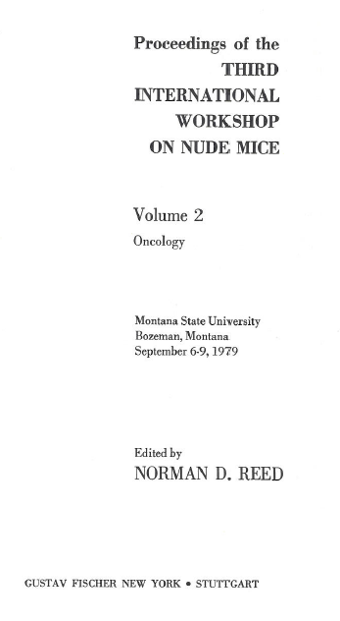
Bibliographic Record
Continuously paged.
Volume 1 has two sequences; last numbered page in each are xx and 330
Volume 2 has two sequences; last page in first is xx; second begins with page 347, last numbered page is 690
Record the extent in the RDA worksheet
Notes:
Note capitalization change.

Slide 130
Bibliographic Record
300 $a 2 volumes (xx, 690 pages)
Notes:
Two reasons for not giving the roman numerals from the second volume: 1. reread last sentence of 3.4.5.17. 2. If you look carefully at the numbering, those numbers are not a separate sequence. There are really only two sequences in this set, the first (ending with xx in v. 1) and the second, which switches back and forth between arabic and roman numerals--it goes 1-330, then xx, then starts again with 347. The volume 2 xx are the missing pages between 330 and 347 (I know the math doesn’t add up perfectly but probably the printer had to fit in a few extra preliminary pages after the second volume was set).

Slide 131
Illustrative and Color Content
(RDA 7.15, 7.17)
This is basically the same as AACR2, except no abbreviations
Instructions are in Chapter 7 (Describing content) because content is an attribute of expression!
Record in subfield $b of 300, following a colon
  300 $a 93 unnumbered pages : $b color illustrations ; $c 30 cm
  300 $a 1 online resource (45 pages) : $b maps (some colour)
Note: RDA does not prescribe the spelling of “color”. LC will use “color,” not “colour.”
Notes:
Read 7.15 and 7.17. together

Slide 132
The Iliad has a map
The Cunningham Cookbook has black and white photographs and a map
Regarding Warhol has color reproductions of art works
The Workshop proceedings have black and white photographs
Masterworks has color reproductions of art works
Record illustrative and color content in the RDA worksheets
Notes:
Note capitalization change.

Slide 133
Relationship of illustrative content and content type
Optionally, you can include further content type elements corresponding to the illustrative (or other) content
245 14 $a The Cunningham family cookbook : $b recipes from our cousins.
300 $a 256 pages : $b illustrations, map
336 $a text $2 rdacontent
336 $a still image $2 rdacontent
336 $a cartographic image $2 rdacontent

Slide 134
Dimensions
3.5.1.1. Dimensions are the measurements of the carrier or carriers and/or the container of a resource.
3.5.1.3. Unless instructed otherwise, record dimensions in centimetres to the next whole centimetre up, using the metric symbol cm (e.g., if the height measures 17.2 centimetres, record 18 cm).
Notes:
Read together 3.5.1.4.14
There is an alternative to record dimensions in another system of measurment preferred by the agency.

Slide 135
Dimensions
“cm” is considered a symbol, not an abbreviation, and so does not have a period unless (because of ISBD) a series is recorded in 490
Record dimensions in 300 subfield $c, following a semicolon

Slide 136
Homer: 23.5 cm
Masterworks: 29.3 cm
Sun stone: 18.6 cm
Cunningham: 22.5 cm
Warhol: 27.4 cm
Workshop: 24.1 cm
Record dimemsions in your worksheets

Slide 137
Bibliographic Records
Homer: 300 $a lxiii, 480 pages ; $c 24 cm
Masterworks: 300 $a 416 pages : $b color illustrations ; $c 30 cm
Sun stone: 300 $a 47 pages ; $c 19 cm.
Cunningham: 300 $a 256 pages : $b illustrations, map ; $c 23 cm
Warhol: 300 $a 304 pages : $b color illustrations ; $c 28 cm
Workshop: 300 $a 2 volumes (xx, 690 pages) : $b illustrations ; $c 25 cm
Notes:
Sun stone has a period at the end because (as we shall see) a series statement is recorded in 490 of its record.

Slide 138
Series Statement (2.12)
Sources (in order of preference): series title page; another source within the resource; any other source.
Record a series statement in 490 exactly as it appears.
First indicator is 0 if the series is unindexed.
First indicator is 1 if the series is indexed. If so there will always be an 8XX field in the description recording the indexed form.
Notes:
Read 2.12 together, including 2.12.2.2 sources

Slide 139
Series
Record the series statement for this resource in your worksheet.

Slide 140
Series
490 0 $a The world poets series
or
490 1 $a The world poets series

Slide 141
Identifier for the Manifestation
2.15. An identifier for the manifestation is a character string associated with a manifestation that serves to differentiate that manifestation from other manifestations
Identifier for the manifestation is core, i.e., required.
Example: ISBN
RDA calls for ISBN to be recorded as is, with hyphens, but MARC does not allow this
Record ISBN in 020 $a, with no hyphens.

Slide 142
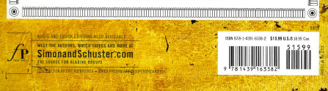
Title page and back cover
Record the identifier for the manifestation in the RDA worksheet
Notes:
Note capitalization change.

Slide 143
Bibliographic Record
020 $a 9781439163382

Slide 144
Title page
Record the identifier for the manifestation in the RDA worksheet
Notes:
Note capitalization change.

Slide 145
Title page and verso
Record the identifier for the manifestation in the RDA worksheet
Notes:
Note capitalization change.

Slide 146
Record the identifier for the manifestation in the RDA worksheet

Slide 147
020 $a 9781588394699 (hc : The Metropolitan Museum of Art)
020 $a 9781588394705 (pbk : The Metropolitan Museum of Art)
020 $a 9780300184983 (hc : Yale University Press)

Slide 148
Title page and versp
Record the identifier for the manifestation in the RDA worksheet
Notes:
Note capitalization change.

Slide 149
020 $a 0895741059 (volume 1 : Gustav Fischer, New York)
020 $a 3437033457 (volume 1 : Gustav Fischer, Stuttgart)
020 $a 0895741040 (volume 2 : Gustav Fischer, New York)
020 $a 3437030025 (volume 2 : Gustav Fischer, Stuttgart)
Notes:
Note in this case each volume has separate ISBNs (I only gave you v. 1); and also the ISBNs associated with the CIP data are apparently incorrectly recorded (v. 1 and 2 switched)

Slide 150
Notes
Notes can relate to the work, expression, manifestation, or item.
No notes are core in RDA.
There is no special section about notes in RDA. Guidelines about notes are scattered throughout the document.
RDA access points do not need to be justified in the body of the record; therefore notes AACR2 catalogers compose simply to justify an added entry do not need to be made in RDA.

Slide 151
Notes related to the manifestation (RDA 2.20)
Note on title (500 or 246)
Note on statement of responsibility (e.g. “at head of title” 500)
Note on edition statement (500)
Note on numbering (515)
Note on frequency (310 or 321)
Note on basis for identification (588)

Slide 152
Notes related to the work
(RDA 7.2-7.9)
7.2. Nature of the content (500)
    Play
7.3. Coverage of the content (500, 513)
    Contains statistics for 1851-1913
7.7. Intended audience (521)
    MPAA rating: PG-13
    For junior high aged children
7.9. Dissertation or thesis information (502)
    Thesis (Ph. D.)--University of Michigan, 1971

Slide 153
Notes related to the work
(RDA 7.2-7.9)
All are recorded as under AACR2, except dissertation information:
    502 $b Ph. D. $c University of Michigan $d 1971
This is intended to display:
    Thesis (Ph. D.)--University of Michigan, 1971.

Slide 154
Note related to the work
(RDA 25, structured description)
The “contents note” is actually a way of recording a whole-part relationship between the resource and its parts. It is recorded in 505.
    505 0 $a 'Til death do us plots / by Julianne Bernstein — Class act / by Michael Elkin — Where's your stuff? / by Daniel Brenner — Foot peddler / by Vivian Green — Smoke / by Louis Greenstein — Single Jewish female / by Julianne Bernstein — In spite of everything / by Hindi Brooks — Ger (the convert) / by Leslie B. Gold and Louis Greenstein — Golden opportunity / by Julianne Bernstein — Interview with a scapegoat / by Louis Greenstein

Slide 155
Notes related to the expression
(RDA 7.10-7.28)
7.10. Summarization of the content (520)
    Two children sitting at home on a rainy day are visited by the cat in the hat who shows them some tricks and games.
7.12. Language of the content (546)
    Sung in French.
7.14. Accessibility content (500, 546)
    Includes presentation of text in Braille.
7.16. Supplementary content (500, 504)
    Includes bibliographical references (pages 20-43) and index.
7.28. Award (586)
    Cybil Award Young Adult Fiction Finalist (2011)
Notes:
A few of the more common expression-related notes.

Slide 156
Notes
Would the records for any of the resources we’ve been describing need notes?
Notes:
DISCUSSION

Slide 157
Some possible notes
245 10 $a Sun stone = $b Piedra de sol / $c Octavio Paz ; translation by Muriel Rukeyser.
500 $a Poem.
546 $a Spanish text with parallel English translation.

Slide 158
Some possible notes
245 00 $a Regarding Warhol : $b sixty artists, fifty years / $c Mark Rosenthal, Marla Prather, Ian Alteveer, Rebecca Lowerey.
500 $a Published in conjunction with the exhibition held at the Metropolitan Museum of Art, New York, September 18-December 31, 2012 and at the Andy Warhol Museum, Pittsburgh, February 2-April 28, 2013.
504 $a Includes bibliographical references (pages 280-287) and index.
505 0 $a Dialogues with Warhol / Mark Rosenthal — Interviews with artists / conducted by Martha Prather — The Warhol effect. A visual archive / Ian Alteveer — The Warhol effect. A timeline / Rebecca Lowery.

Slide 159
Some possible notes
245 10 $a Masterworks from the Butler Institute of American Art / $c Martha L. Menk, editor ; Joseph P. Rudinec, photography.
504 $a Includes bibliographical references (pages 385-398) and index.

Slide 160
Some possible notes
245 14 $a The Iliad / $c Homer ; translated, with an introduction and notes, by Stephen Mitchell.
504 $a Includes bibliographical references (pages 477-478).

Slide 161
Some possible notes
245 10 $a Proceedings of the Third International Workshop on Nude Mice / $c edited by Norman D. Reed.
504 $a Includes bibliographical references and index.
505 0 $a v. 1. Invited lectures, infection, and immunology -- v. 2. Oncology.

Slide 162
Some possible notes
245 14 $a The Cunningham family cookbook : $b recipes from our cousins / $c cookbook committee, Linda Rhudy, Charlotte Cunningham Wilson, Beth Cunningham, Sarah Neighorgall, Joyce Banister, Paula Cunningham.
500 $a Includes indexes.

Slide 163
Exercise
Create descriptions for the following two manifestations
Work together on manifestation/item (and bib record work/expression) description that you’ve brought to practice on

Slide 164

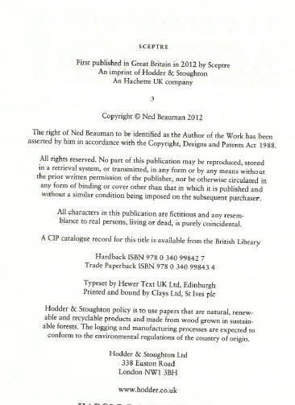
Last numbered page = 357
No illustrations
Size: 22.3 cm

Slide 165

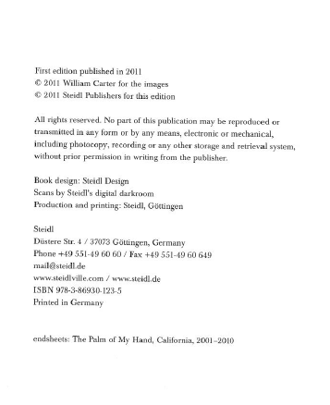
Last numbered page = 293
Black and white photographs
Size = 28.6 cm
Colophon

Slide 166
Module 10
Describing Manifestations (and some attributes of Works and Expressions)
Questions?
RDA Training
University of Nevada, Reno
February 2013

Slide 167
This Presentation is available at
http://net.lib.byu.edu/~catalog/people/rlm/RDAReno201302/index.htm
For further information
contact Robert L. Maxwell
robert_maxwell@byu.edu

